Slide 1




World Cup 2023
Allan Cheerakunnil Alex
Batch MIP-ML-08

Slide 2
Agenda
Introduction
Objective
Importing Libraries
EDA - Exploratory Data Analysis
Data visualisation, Story telling & Experimenting with charts
Conclusion

Slide 3
Introduction
The Cricket World Cup stands as a pinnacle event in the realm of cricket, where nations compete fiercely for glory on the pitch. The 2023 edition of this prestigious tournament showcased thrilling matches, outstanding performances, and unforgettable moments that left an indelible mark on the cricketing world. In this project, we embark on a journey to uncover the intricacies of the 2023 Cricket World Cup through comprehensive data analysis.

Slide 4
Objective
The primary objective of this project is to delve deep into the dataset encapsulating the 2023 Cricket World Cup, conducting an extensive exploratory data analysis (EDA) to extract valuable insights. By analyzing team performances, player statistics, match outcomes, and other pertinent factors, we aim to unravel the underlying trends, patterns, and dynamics that shaped the tournament.

Slide 5
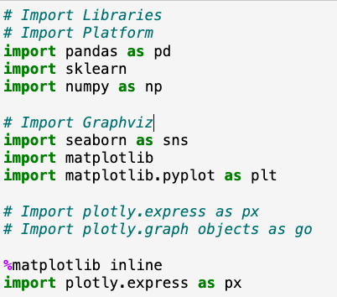
Import Libraries
Pandas - Data Manipulation
Sklearn - Scikit Learn Powerful Machine Learning Library
Numpy - Numerical Computation
Seaborn - Statistical Data Visualisation
Matplotlib - Data Visualisation
Plotly.express - Python library used for creating interactive data visualisations.

Slide 6
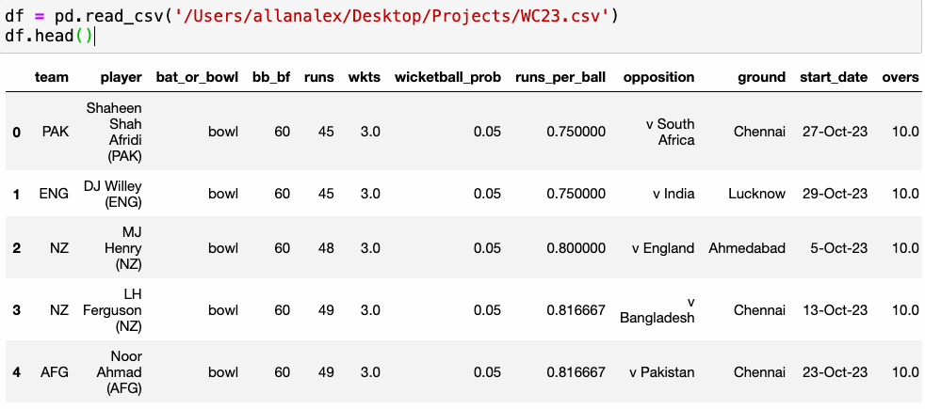
This line reads CSV file named WC23 and stores the data into a panda’s data frame.
Df.head() - It gives top 5 rows with columns.

Slide 7
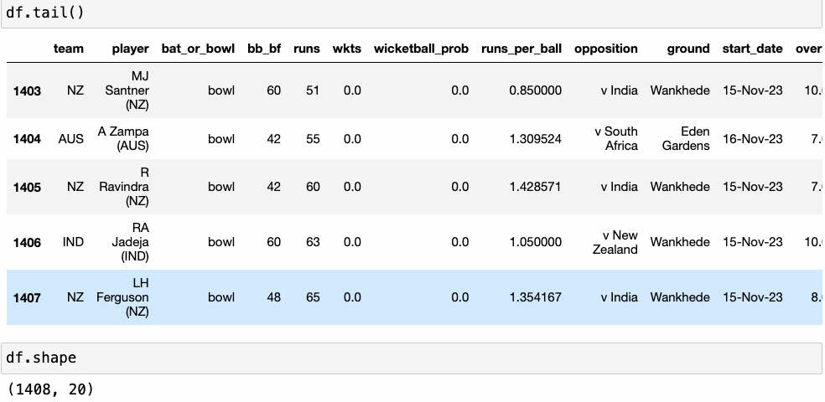
Df.tail() - It gives bottom 5 rows and columns
Df.shape - It displays rows and columns.

Slide 8
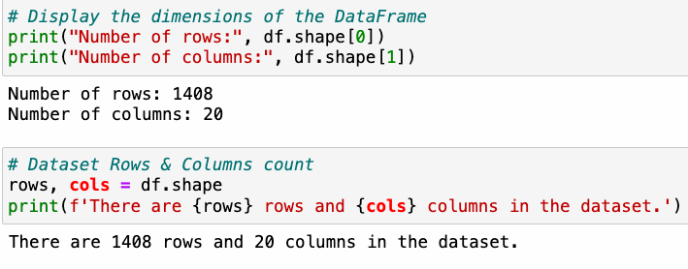
Df.shape[0] - Displays number of rows.
Df.shape[1] - Displays number of columns.
Df.shape - It displays rows and columns

Slide 9
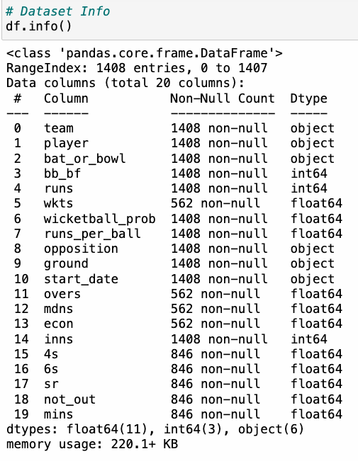
df.info() - It provides concise summary of the data frame.

Slide 10
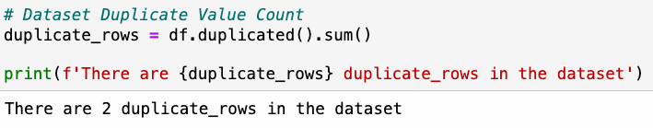
It will check if there is any duplicate rows present in the dataset.

Slide 11
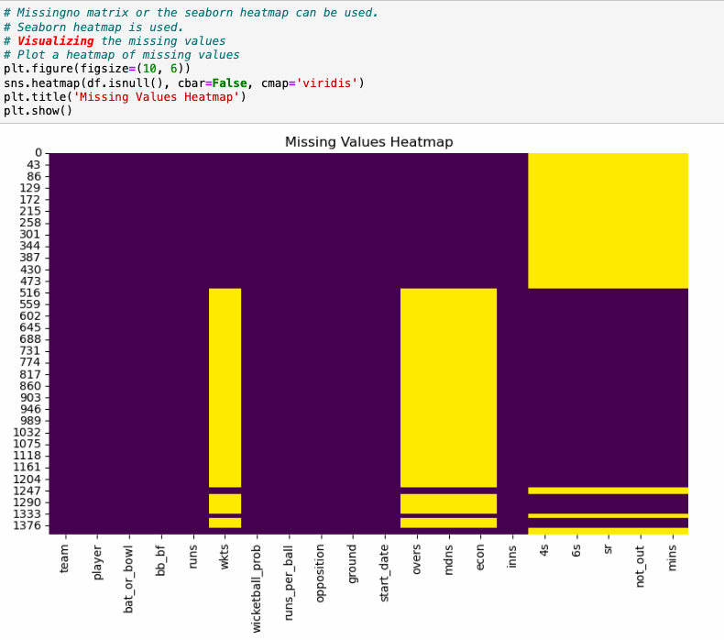
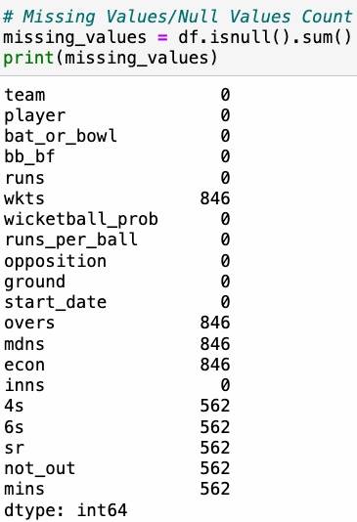
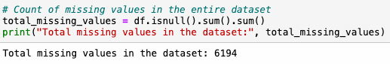

Slide 12
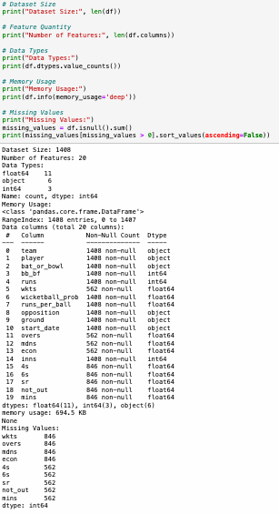

Slide 13
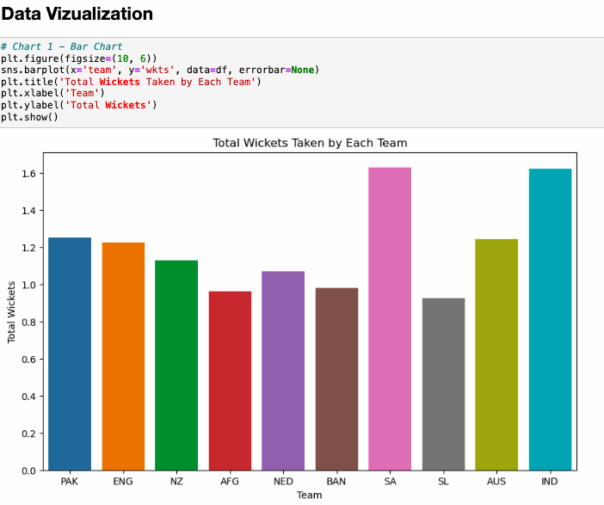
Type of Chart: The chart is a bar chart, specifically created using the barplot function from the seaborn library.
Visualization: Each bar in the chart represents a different team, and the height of the bar corresponds to the total number of wickets taken by that team.
this bar chart provides a visual comparison of the total number of wickets taken by each cricket team, allowing viewers to quickly identify which teams have been most successful in terms of bowling performance.

Slide 14
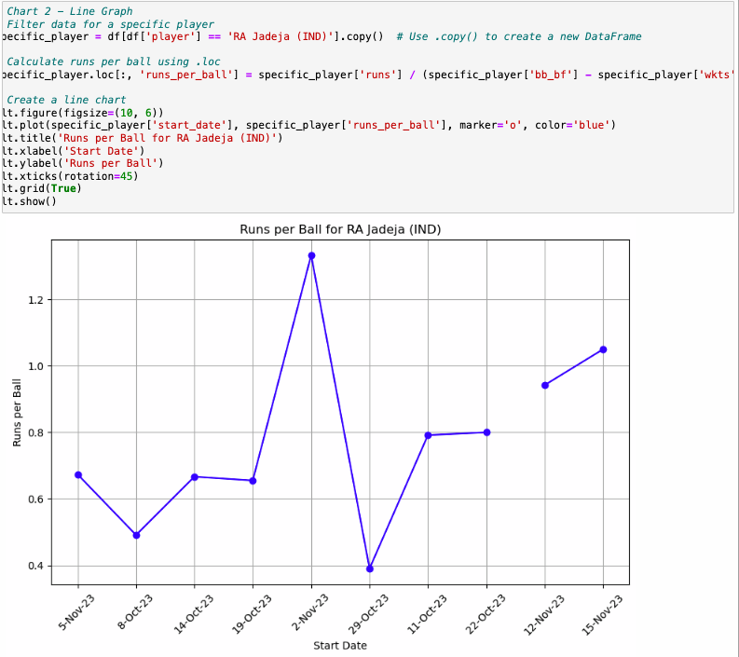
Type of Chart: The chart is a line graph, created using the plot function from the matplotlib library.
Visualization: Each point on the line represents a specific date (start_date) and the corresponding runs per ball ratio achieved by the player on that date.
This line graph provides a visual representation of the runs per ball achieved by RA Jadeja during matches played, allowing viewers to observe trends and fluctuations in the player's performance over time.

Slide 15
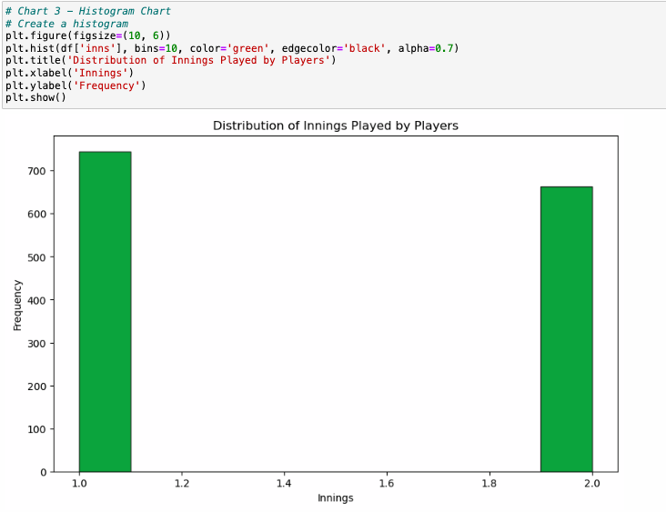
Type of Chart: The chart is a histogram, created using the hist function from the matplotlib library.
Visualization: The histogram displays the distribution of the number of innings played by players. The x-axis represents the number of innings, divided into bins (intervals), and the y-axis represents the frequency (i.e., the number of players falling within each bin).
This histogram provides insights into the distribution of the number of innings played by players, allowing viewers to understand the frequency and spread of player participation across different innings ranges.

Slide 16
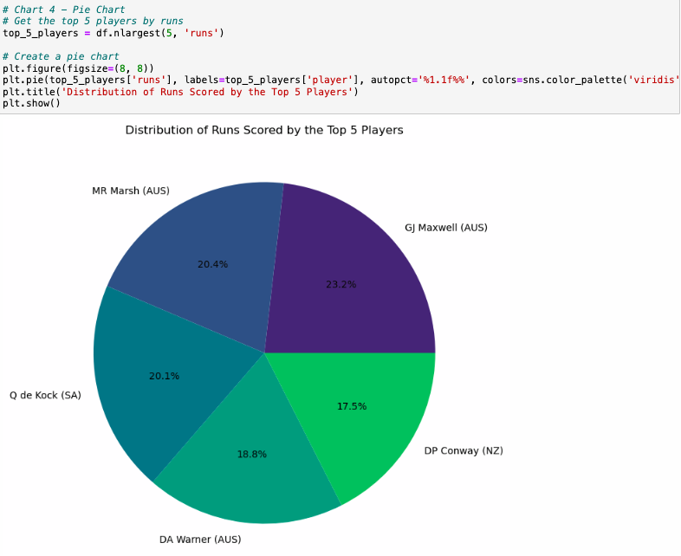
Type of Chart: The chart is a pie chart, created using the pie function from the matplotlib library.
Visualization: The pie chart displays the distribution of runs scored by the top 5 players. Each segment of the pie represents a player, and the size of each segment is proportional to the number of runs scored by that player.
This pie chart provides a visual representation of the contribution of each of the top 5 players towards the total runs scored during the tournament, allowing viewers to quickly grasp the distribution of runs among these key players.

Slide 17
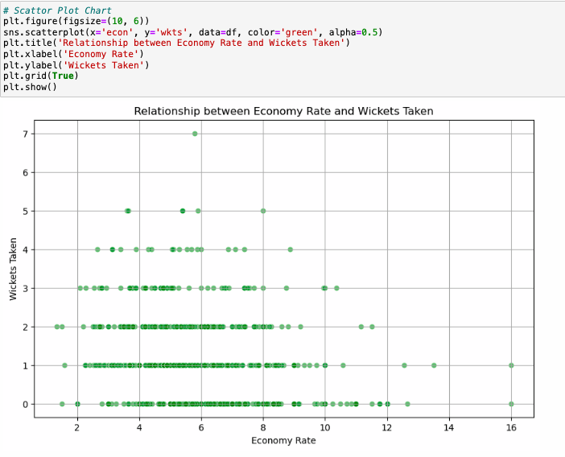
Type of Chart: The chart is a scatter plot, created using the scatterplot function from the seaborn library.
Visualization: Each point on the scatter plot represents a data point corresponding to a specific combination of economy rate and wickets taken by a player or team.
This scatter plot provides a visual representation of the relationship between economy rate and wickets taken, allowing viewers to identify any potential patterns or correlations between these two variables.

Slide 18
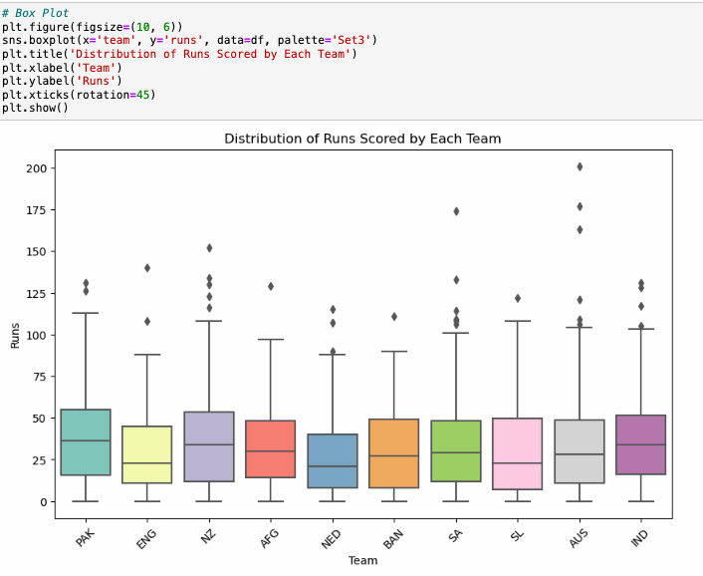
Type of Chart: The chart is a box plot, created using the boxplot function from the seaborn library.
Visualization: The box plot displays the distribution of runs scored by each team. Each box represents the interquartile range (IQR) of runs scored by a particular team, with the median indicated by the horizontal line inside the box. The whiskers extend to the minimum and maximum values within 1.5 times the IQR from the first and third quartiles, respectively.
This box plot provides a visual representation of the distribution of runs scored by each cricket team, allowing viewers to identify central tendencies, variations, and potential outliers in team performances.

Slide 19
Conclusion
Through rigorous data analysis and exploration, this project aims to offer valuable insights into the dynamics of the 2023 Cricket World Cup. By dissecting the tournament's data from various angles, we strive to uncover hidden patterns, illuminate standout performances, and provide a deeper understanding of the cricketing spectacle that captivated audiences around the globe. Join us as we unravel the stories etched on the pitch and celebrate the spirit of cricket showcased in the 2023 Cricket World Cup.

Slide 20
Thank You

